Slide 1
Texas Essential Knowledge and Skills
The student is expected to:
Expressions, equations, and relationships—7.7
Apply mathematical process standards to represent linear relationships using multiple representations.
Mathematical Processes
7.1.E
Create and use representations to organize, record, and communicate mathematical ideas.

Slide 2
Representing Linear Relationships Using Tables and Verbal Descriptions
How do you use tables and verbal descriptions to describe a linear relationship?

Slide 3
Background
In a linear relationship between two quantities, as one quantity changes by a constant amount, the other quantity also changes by a constant amount.

Slide 4
Background
There are several ways to describe a linear relationship.
Tables
Verbal Descriptions
Equations
Graph

Slide 5
Example 1 Verbal Description
Luis will participate in a walkathon for
charity. He received a pledge from his
aunt, and the table shows the relationship
between the miles walked by Luis and the
amount his aunt pledged.
Miles Walked (X) | 1 | 2 | 3 | 4
Amount Pledged (Y) | $31.50 | $33.00 | $34.50 | $36.00

Slide 6
How much more money than $1.50 Luis’ aunt is pledging for 1 mile walked.
31.50 – 1.50 = $30.00 more
Miles Walked (X) |  | 1 | 2 | 3 | 4
Amount Pledged (Y) |  | $31.50 | $33.00 | $34.50 | $36.00

Slide 7
Example 1 Verbal Description
Give a verbal description for the relationship between the miles walked by Luis and amount of money pledged by is aunt.
Luis’s aunt pledged $30 plus an additional $1.50 for each mile he walks.

Slide 8
EXAMPLE 2
The Ecology Club is holding a car wash to raise money. The club received a pledge from its parent group. The table shows the relationship between the number of cars washed and the amount the parent group pledged. Use the table to give a verbal description of the relationship between cars washed and amount pledged.
The parent group pledged $75 plus an additional $4.50 for each car washed.

Slide 9
Example 3. Your turn
Jodi buys her movie tickets online. The table below shows the cost for each ticket including a convenience fee. Write a verbal description that describes the relationship
Number of Tickets | Cost
1 | 7
2 | 12
3 | 17
4 | 22
8 | 42

Slide 10
Summary
I can determine if data in a table represents a linear relationship by……..

Slide 11
Summary
I can determine if data in a table represents a constant rate of change if one quantity changes by a constant amount and the other quantity also changes by a constant amount.

Slide 13
Representing Linear Relationships Using Equations and Graphs
How do you use tables and verbal descriptions to describe a linear relationship?

Slide 14
Linear Relationships - Equations
You can write an equation to represent a linear relationship using y= mx + b.
“y” is your dependent variable
“x” is your independent variable
“m” represents the rate of change
“b” represents the value of y when x is zero (It’s what you start with)

Slide 15
Write a linear equation that describes the relationship between miles walked and amount pledged.
Step 1. Look for patterns in the different values for miles walked and amount pledged.
Miles Walked (X) | 1 | 2 | 3 | 4
Amount Pledged (Y) | $31.50 | $33.00 | $34.50 | $36.00

Slide 16
Set up a Table w/the process
Step 1. Look for patterns in the different values for miles walked and amount pledged.
Miles Walked (X) | Process | Amount Pledged (Y)
1 |  | $31.50
2 |  | $33.00
3 |  | $34.50
4 |  | $36.00
X |  | Y
+1
+1.50
+1
+1.50
+1
+1.50

Slide 17
Set up a Table w/the process
Step 2. Find the rate that represents the amount pledged per mile walked.
Miles Walked (X) | Process | Amount Pledged (Y)
1 |  | $31.50
2 |  | $33.00
3 |  | $34.50
4 |  | $36.00
X |  | Y
$\frac{Δ y}{Δ x} =\frac{1.50}{1} =$
$$\$1.50 per mile$$
+1
+1.50
+1
+1.50
+1
+1.50

Slide 18
Set up a Table w/the process
Step 2. Find the rate that represents the amount pledged per mile walked.
Miles Walked (X) | Process | Amount Pledged (Y)
1 | 1.50 (1) | $31.50
2 | 1.50(2) | $33.00
3 | 1.50(3) | $34.50
4 | 1.50 (4) | $36.00
x | 1.50x | y
$$\frac{1.50}{1} =\$1.50 per mile$$
+1
+1.50
+1
+1.50
+1
+1.50
+1
+1.50

Slide 19
Set up a Table w/the process
Step 3 Determine how much more money than $1.50 Luis’ aunt is pledging for 1 mile walked.
Miles Walked (X) | Process | Amount Pledged (Y)
1 | 1.50x +30 | $31.50
2 | 1.50x +30 | $33.00
3 | 1.50x +30 | $34.50
4 | 1.50x +30 | $36.00
X | 1.50x +30 | Y
31.50 – 1.50 = $30.00 more
+1
+1.50
+1
+1.50
+1
+1.50

Slide 20
Example 1
How would we write this relationship in the form of Y= mx + b.
Y= 1.50x + 30

Slide 21
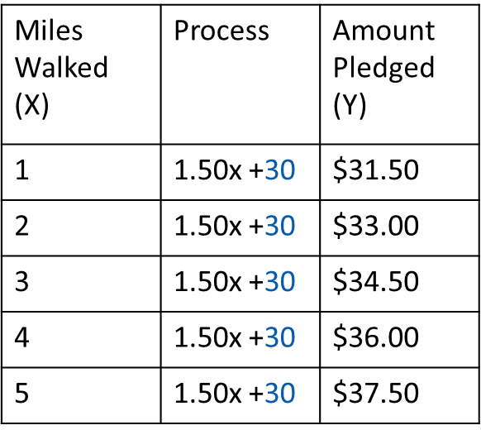
Example 1 – Graphing
To graph a linear relationship, use the values in the table to create ordered pairs (X, Y).
(0, 30)
(1, 31.5)
(2, 33)
(3, 34.5)
(4, 36)
(5, 37.5)

Slide 22
Example 1 – Graphing
Then plot the points
(0, 30)
(1, 31.5)
(2, 33)
(3, 34.5)
(4, 36)
(5, 37.5)

Slide 23
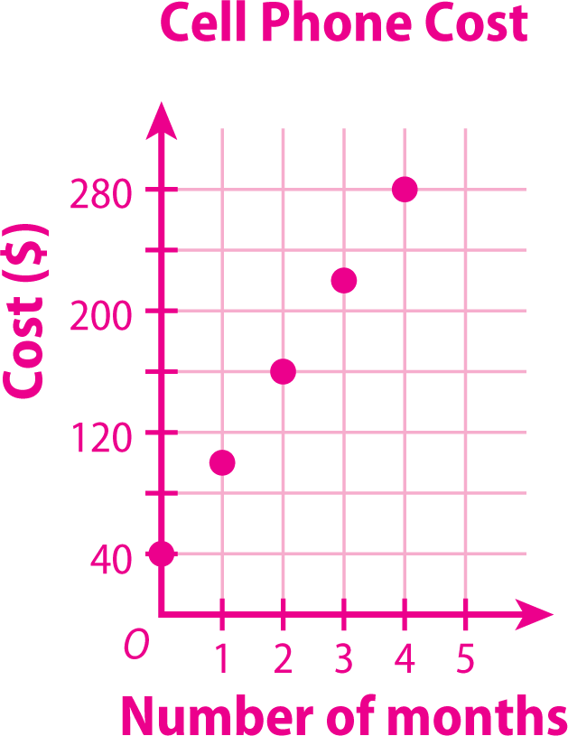
ADDITIONAL EXAMPLE 2
Kyle has signed up for a cell phone plan that costs $60 per month plus a one-time activation fee of $40. Represent the relationship using a table, an equation, and a graph.
y = 60x + 40
Month (X) | Process | Cost (Y)
1
2
3
4
x | 60 (x) + 40 | y

Slide 24
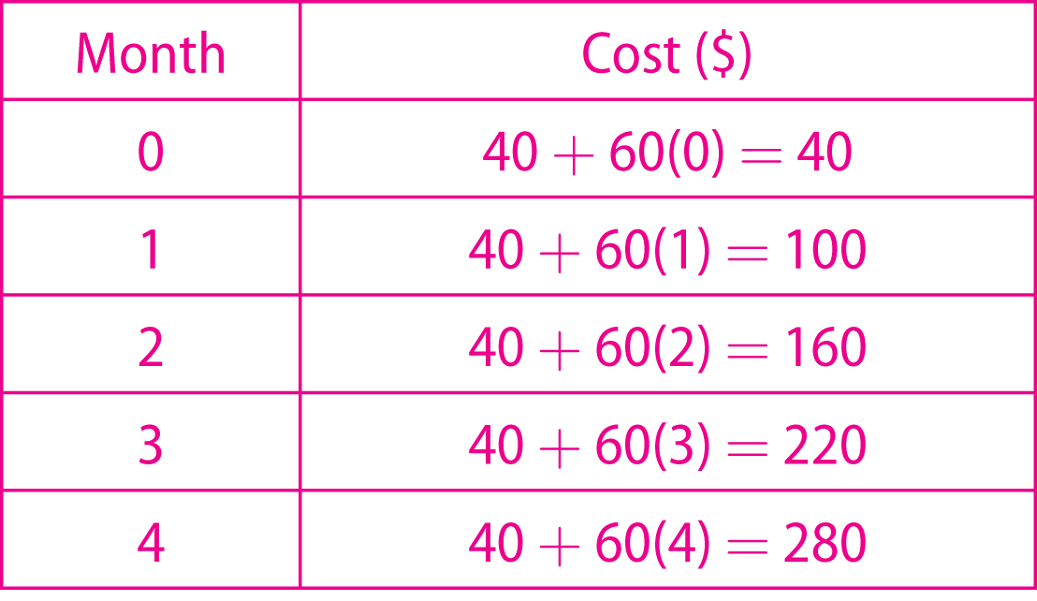
ADDITIONAL EXAMPLE 2
Kyle has signed up for a cell phone plan that costs $60 per month plus a one-time activation fee of $40. Represent the relationship using a table, an equation, and a graph.
y = 60x + 40

Slide 25
Example 3
Maris has a dog-babysitting business for which she charges each customer per hour plus an initial fee. Write an equation to describe the relationship between the cost and the amount of hours she babysits.
Number of Hours (X) | Process | Cost (Y)
1 |  | 13
2 |  | 16
3 |  | 19
4 |  | 22
X |  | Y
Y= 3x + 10

Slide 26
2.
Maris has a dog-babysitting business after school for which she charges each customer $3 per hour plus an additional $10.
A. State the meaning of the ordered pair (8, 34).
If you walk a dog for 8 hours in one week, you will earn $34.

Slide 27
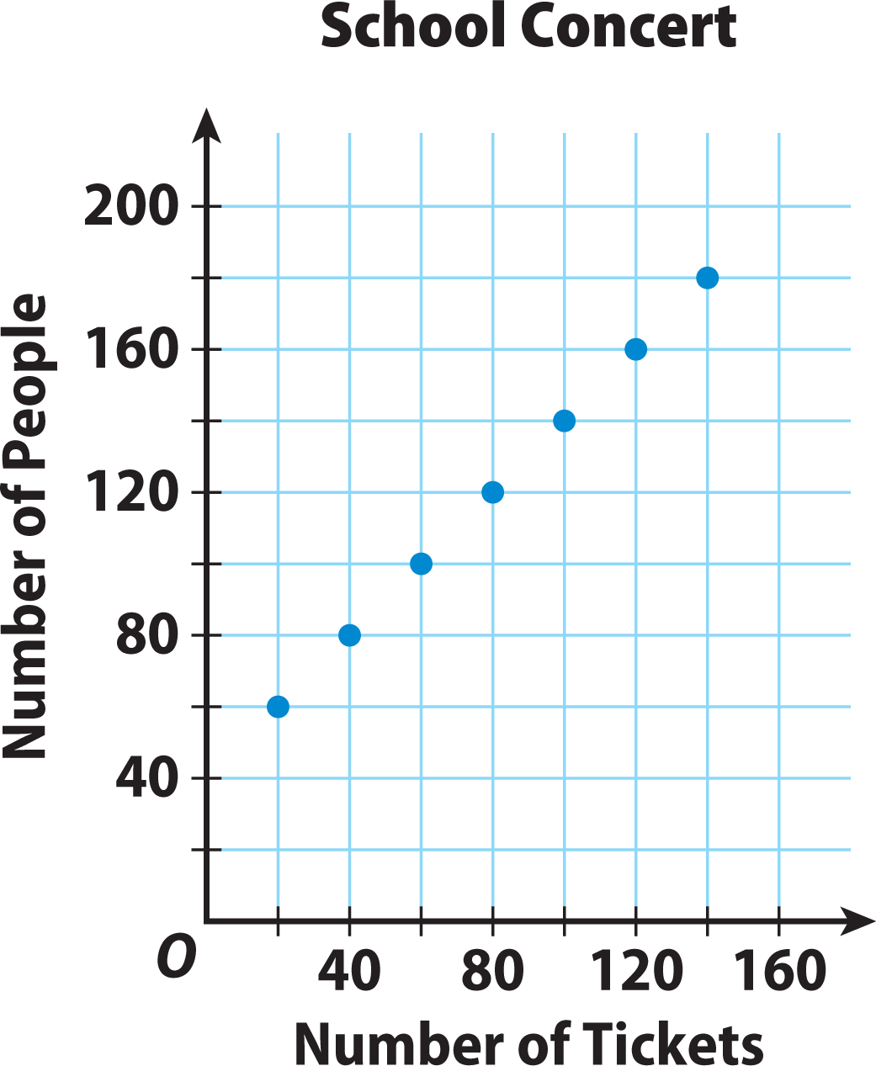
The scatter plot shows the relationship between the number of tickets sold and the number of people attending a school concert. Make a table of values from the scatter plot. Then give a verbal description of the relationship between the number of tickets sold and the number of people attending the concert.

Slide 28
The number of people attending the concert is the number of tickets sold plus 40.

Slide 30
3.
Joseph is saving money each week to buy a new bicycle. The table below represents his total savings so far based on the number of weeks he has been saving. Give a verbal description of the relationship between weeks and savings.
The savings is $8 times the number of
weeks plus $10.

Slide 31
7.1 LESSON QUIZ
7.7
1.
A principal is ordering new books. The number of books she orders is 25 times the number of classes plus 8. Represent the relationship between the number of books ordered and the number of classes in the table below.

Slide 32
How do you use tables and verbal descriptions to describe a linear relationship?
Sample answer:
Look for patterns in a table to show that as one quantity changes by a constant amount, the other quantity also changes by a constant amount. Then put the pattern into words that describe a linear relationship.

Slide 33
3.
The school band sold T-shirts for a fundraiser. They earned $6 profit on each T-shirt minus $4 for flyers. Give a verbal description relating the number of T-shirts and the profit. Find the profit for selling 30 T-shirts.
The profit for the fundraiser is $6 times the number of T-shirts minus $4; $176.

